Slide 1

Face Recognition using Convolution Neural Networks
GitHub Link: https://github.com/syamkakarla98/Face_Recognition_Using_Convolutional_Neural_Networks
Batch No: B – 01
M. Sai Rahul (164G1A0589)
Syam Kakarla (164G1A05B0)
G. Priyaranjan Reddy (164G1A0571)
C. Sai Charan Singh (164G1A0584)
Project Guide
Dr. T. Hitendra Sarma, Ph.D., Professor
Srinivasa Ramanujan Institute of Technology
Department of Computer Science & Engineering

Slide 2
Introduction
Biometric systems can add great convenience by replacing passwords, helping law enforcement catch criminals and even in organizations in posting the attendance of an employee
Several types of Biometric systems are available like Face Recognition, Fingerprint Scanner, Voice Recognition etc.
Face Recognition generally measures the unique patterns of a person’s face by comparing and analysing facial contours

Slide 3
Cont…
Face Recognition system is being used by some organization to track the attendance of the employees
The project proposes a novel CNN model for Face recognition and also address the different challenges that occur to develop an end to end Face Recognition System which is furtherly used for Attendance Posting

Slide 4
Existing System
There are several classification models used for face recognition like:
Eigen Face Recognition
Fischer Face Recognition
Local Binary Pattern Histogram ( LBPH )
Some pre-processing techniques includes:
PCA
LDA

Slide 5
Proposed System
The proposed system is based on convolutional neural networks which performs feature extraction automatically
This project aims to develop an end-to-end process to build a custom facial recognition system using convolutional neural network.

Slide 6
Abstract
Convolutional Neural Networks (CNNs) has been playing a significant role in solving Computer Vision problems
The Conventional Facial Recognition system uses biometrics to map facial features from a photograph or video by comparing the information resides in the database to find a match
The project proposes a novel CNN architecture for Face Recognition and a pipeline to develop an end-to-end facial recognition system which includes collecting real time data

Slide 7
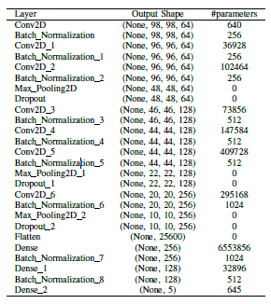
CNN Architecture

Slide 8
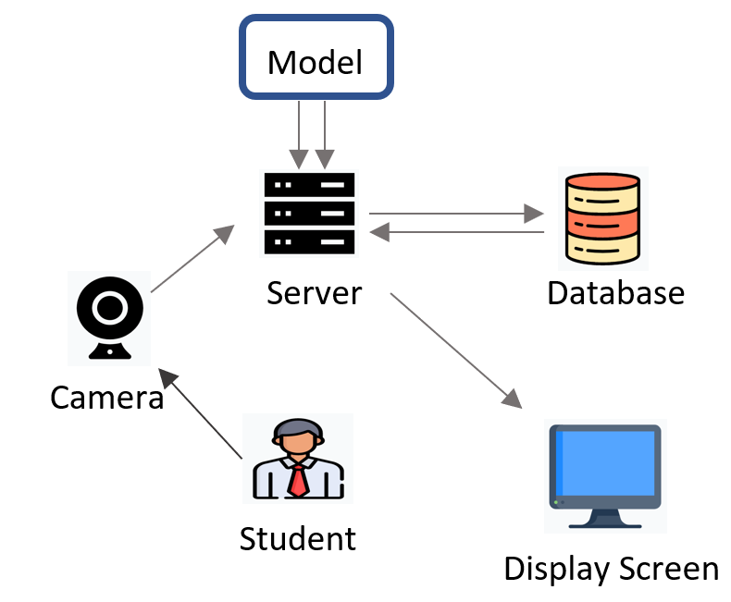
Web Application Architecture

Slide 9
Cont…
The main components of the application are:
1) Front-End Interface (Camera)
2) Server
3) CNN Model
4) Database
5) End Result (Display Screen)

Slide 10
Cont…
Front-End Interface is a web page which takes the video frame as input through the camera using open computer vision (OpenCV) library.
Server is the back-end of the application which maintains the connection with front-end interface, model, database and display screen.

Slide 11
Cont…
The server checks if the attendance is posted previously. If not, the attendance is posted into the database including the timestamp.
The details of the corresponding student will be shown using the display screen, which is web page.

Slide 12
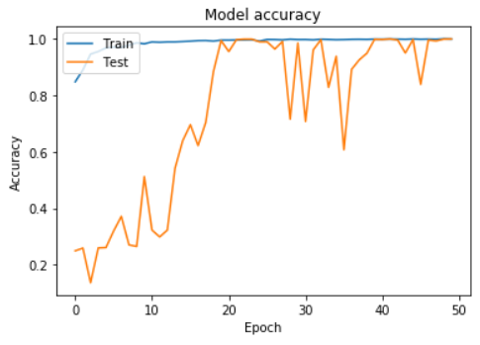
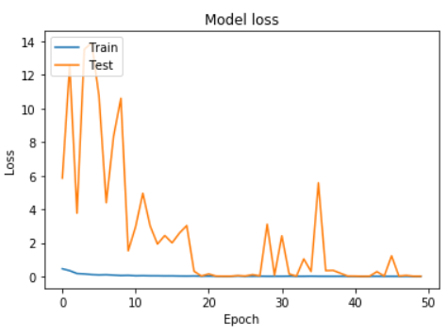
Training the CNN
The following parameters are also used in training process:
Optimizer – RMSProp
Learning Rate – 0.001
Loss Metric – Categorical Cross Entropy
Batch Size – 256
Epochs – 50
The time taken to train the model is 27min 30sec

Slide 13
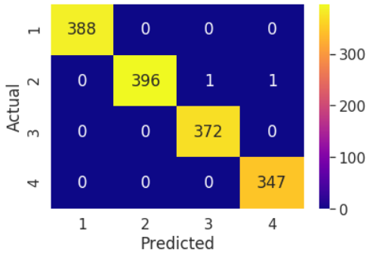
Results
Confusion Matrix Classwise Accuracy
Class Label | Accuracy
1 | 100%
2 | 99.49%
3 | 100%
4 | 100%
Classification Metrics
Metric | Value
Classification Accuracy | 99.8671%
Precision | 99.861%
Recall | 99.874%
F1 Score | 99.867%
Kappa Score | 99.822%

Slide 14
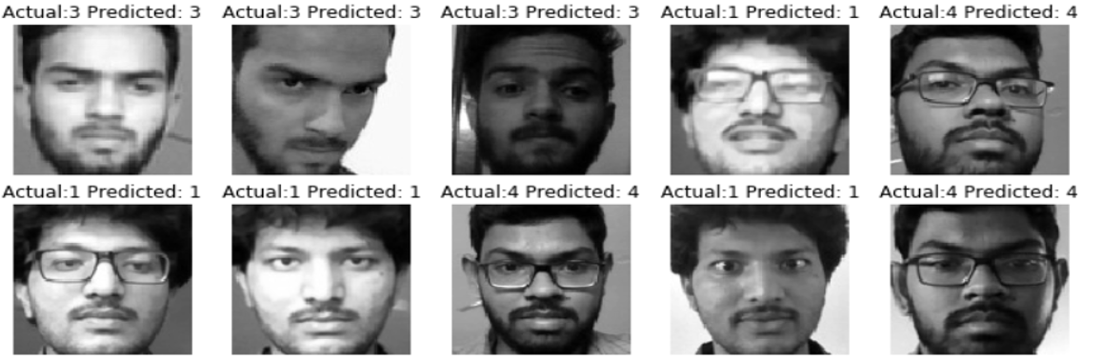
Results
Predictions of Sample Test images

Slide 15
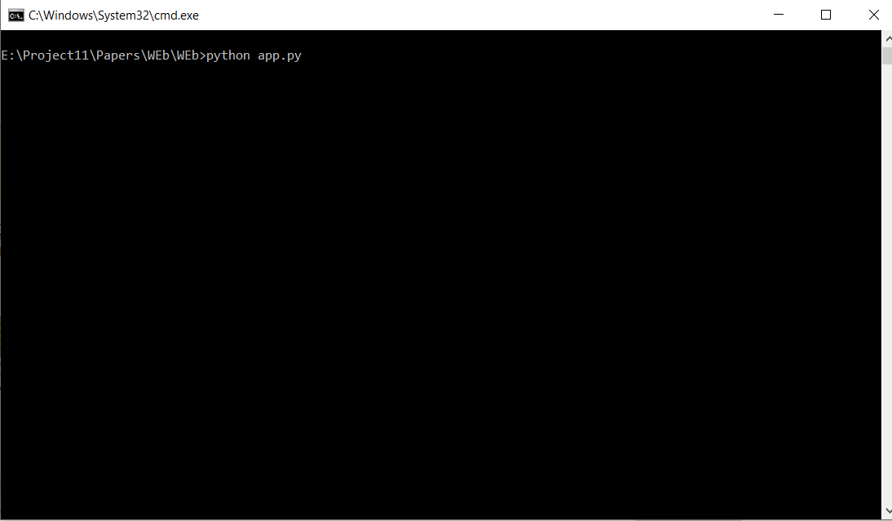
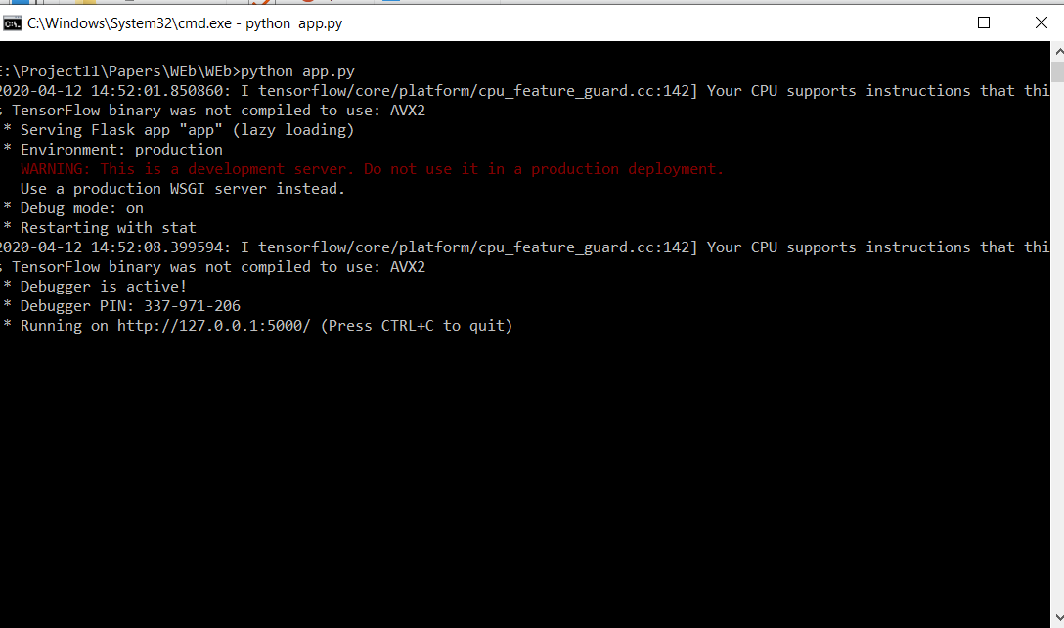

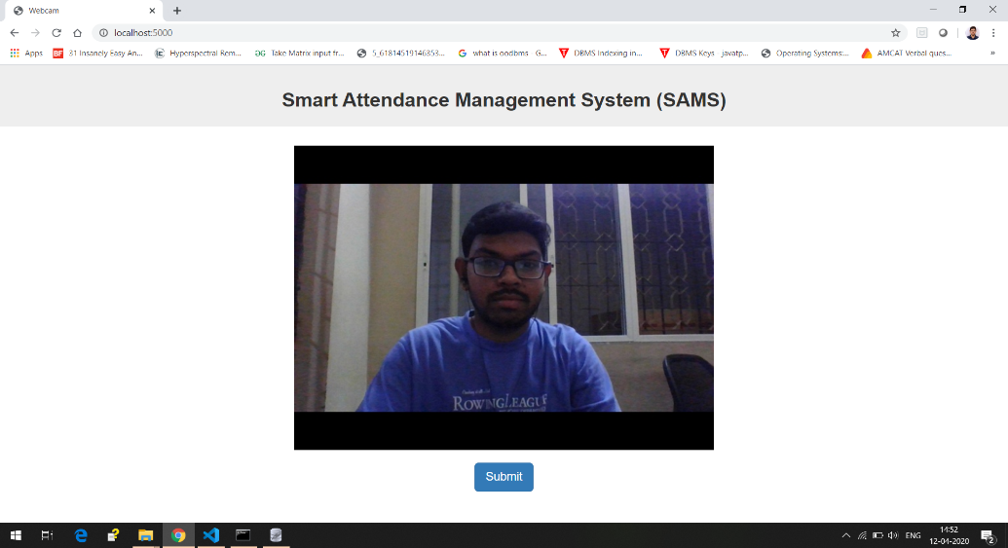
Results
Web Application
1. Command to run the web application
2. Localhost Address
3. Adding Localhost Address in Browser
4. Web Application

Slide 16




Results
5. Screenshots of
Posted Result
6. Timestamps Recorder in Database w.r.t Period

Slide 17
Conclusion
The project formally introduces the role of Convolutional Neural Networks (CNNs) in Face Recognition and adaption of CNN in attendance posting and also proposes a novel CNN architecture for Face Recognition
The project also provides in detailed explanation on the key components which are essential to build a robust deep learning model, such as collecting real-time data i.e., Human Faces, Data Augmentation and Pre-Processing, Training and Hyper Parameter Tuning the proposed CNN model.

Slide 18
Cont…
The future scope of the project is to build the dataset with more number of classes and to train the proposed CNN model as the project uses only four classes
To build a robust web application with different features such as Login Page, Attendance Management, Student Section, Faculty Section etc.

Slide 19

We are happy to share our research paper entitled
Smart Attendance Management System Based on Face Recognition Using CNN
Accepted
to

Slide 20
Thank you
Queries
?

